Slide 1

A Dive Into Airway Review Data:
Evaluation Metrics and Variable Contribution Visualization

Slide 2
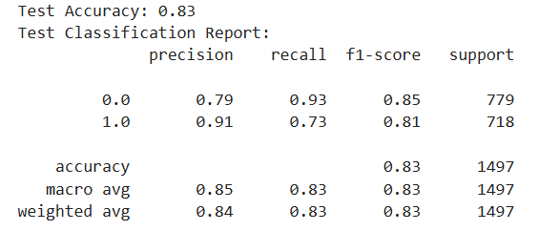
Classification Report
Model is quite effective at predicting whether a customer will make a booking or not.
Booking Predictions: It excels in identifying cases where a booking is made, evidenced by high precision for "booking" (0.91). However, it misses some booking cases, as indicated by a lower recall for "booking" (0.73). This means while the model is accurate when it predicts a booking, it could improve in capturing more of the true booking cases.
No Booking Predictions: The model demonstrates high recall for "no booking" (0.93), meaning it effectively identifies customers who will not make a booking. This is advantageous if the cost of incorrectly predicting a booking is significant.
Overall Performance: Overall, the model performs well, especially in predicting non-bookings, and maintains good accuracy in booking predictions. The balance between precision and recall suggests the model is robust but could be optimized further to improve recall for the booking class.
Cross –Validation score

